Slide 1

Lecture 2
Scope of Microeconomics

Slide 2
The Scope of Economics
There are two major divisions of economics: microeconomics and macroeconomics.
Microeconomics is the branch of economics that examines the functioning of individual industries and the behaviour of individual decision-making units—that is, firms and households.
Macroeconomics is the branch of economics that examines the economic behaviour of aggregates—income, employment, output, and so on—on a national scale.

Slide 3
The Method of Economics
Economics asks and attempts to answer two kinds of questions: positive and normative.
Positive economics attempts to understand behaviour and the operation of economic systems without making judgments about whether the outcomes are good or bad.
It strives to describe what exists and how it works.
What determines the wage rate for unskilled workers? What would happen if we abolished the corporate income tax? The answers to such questions are the subject of positive economics.

Slide 4
The Method of Economics
In contrast, normative economics looks at the outcomes of economic behaviour and asks whether they are good or bad and whether they can be made better.
Normative economics involves judgments and prescriptions for courses of action.
Should the government subsidize the cost of higher education? Should the United States allow importers to sell foreign-produced goods that compete with U.S.-made products? Should we reduce or eliminate inheritance taxes?
Normative economics is often called policy economics.

Slide 5
Basic Three Economic Problems
The key features of the market system help explain how market economies respond to three fundamental economic problems:
What goods and services will be produced?
How will the goods and services be produced?
Who will get the goods and services?
These three questions reflect the reality of scarce resources in a world of unlimited wants.
All economies, whether market or command, must address these three questions.

Slide 6
Basic Three Economic Problems
What goods and services will be produced?
How will a market system decide on the specific types and quantities of goods to be produced?
The simple answer is this: The goods and services that can be produced at a continuing profit will be produced, while those whose production generates a continuing loss will be discontinued.
In the market system, consumers are sovereign (in command). Consumer sovereignty is crucial in determining the types and quantities of goods produced.

Slide 7
Basic Three Economic Problems
What goods and services will be produced?
If the dollar votes for a certain product are great enough to create a profit, businesses will produce that product and offer it for sale.
In contrast, if the dollar votes do not create sufficient revenues to cover costs, businesses will not produce the product.

Slide 8
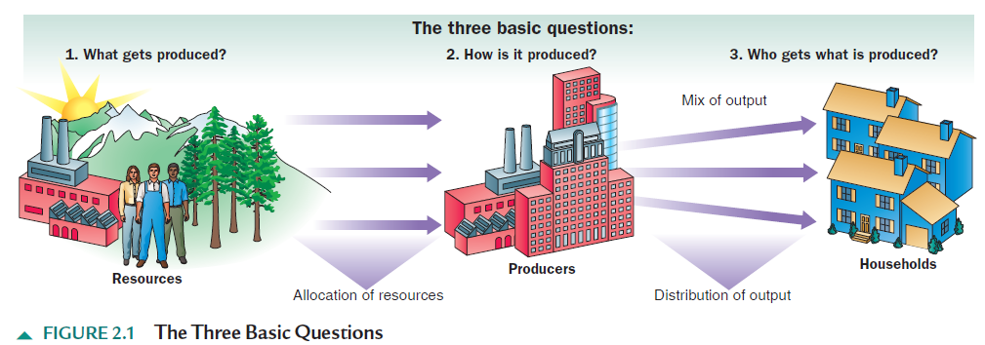
Basic Three Economic Problems

Slide 9
Basic Three Economic Problems
How Will the Goods and Services Be Produced?
What combinations of resources and technologies will be used to produce goods and services?
The answer: In combinations and ways that minimize the cost per unit of output. This is true because inefficiency drives up costs and lowers profits.
As a result, any firm wishing to maximize its profits will make great efforts to minimize production costs. These efforts will include using the right mix of labour and capital, given the prices and productivity of those resources.

Slide 10
Basic Three Economic Problems
Who Will Get the Output?
The market system enters the picture in two ways when determining the distribution of total output.
Generally, any product will be distributed to consumers on the basis of their ability and willingness to pay its existing market price.
If the price of some product, say, a small sailboat, is $3,000, then buyers who are willing and able to pay that price will “sail, sail away.” Consumers who are unwilling or unable to pay the price will be “sitting on the dock of the bay.”

Slide 11
Basic Three Economic Problems
Who Will Get the Output?
The ability to pay the prices for sailboats and other products depends on the amount of income that consumers have, along with the prices of, and preferences for, various goods.
If consumers have sufficient income and want to spend their money on a particular good, they can have it.
The amount of income they have depends on (1) the quantities of the property and human resources they supply and (2) the prices those resources command in the resource market.

Slide 12
Basic Three Economic Problems
Who Will Get the Output?
Resource prices (wages, interest, rent, profit) are crucial in determining the size of each person’s income and therefore each person’s ability to buy part of the economy’s output.
If a lawyer earning $200 an hour and a janitor earning $10 an hour both work the same number of hours each year, then each year the lawyer will be able to purchase 20 times more of society’s output than the janitor.

Slide 13
Economic Systems
Economic Systems
Every society needs to develop an economic system—a particular set of institutional arrangements and a coordinating mechanism—to respond to the economizing problem.
The economic system has to determine what goods are produced, how they are produced, who gets them.
Economic systems differ as to (1) who owns the factors of production and (2) the method used to motivate, coordinate, and direct economic activity.

Slide 14
Economic Systems
Economic Systems
Economics systems can be classified by the degree to which they rely upon decentralized decision making based upon markets and prices or centralized government control based upon orders and mandates.
At one extreme lies laissez-faire capitalism or market economy in which government intervention is at a very minimum and markets and prices are allowed to direct nearly all economic activity.
At the other extreme lie command systems, in which governments have total control over all economic activity.

Slide 15
Economic Systems
The Command System
In command system, government owns most property resources and economic decision making is set by a central economic plan created and enforced by the government.
The command system is also known as socialism or communism.
Under the command system, a central planning board appointed by the government makes all the major decisions concerning the use of resources, the composition and distribution of output, and the organization of production.

Slide 16
What we have learnt…..?
The Scope Economics
The Methods of Economics
Basic Economic Problems
Different Economic Systems

Slide 17


Slide 18
The End

